Slide 1


Corporate Restructuring Strategies
How Companies Adapt to Market Disruption and
Ensure Long Term Sustainability

Slide 2
Understanding Corporate Restructuring
Corporate restructuring means making big changes in how a company works from its setup and strategy to how it runs day to day all to solve problems and do better in the long run. It’s not just small fixes, but a full makeover of the business
The corporate restructuring space has been growing steadily around 5.6% each year since 2018 and it’s expected to pick up speed over the next decade. Why? Because businesses need to keep up with market shifts, new tech and rising expectations from customers and investors.

Slide 3
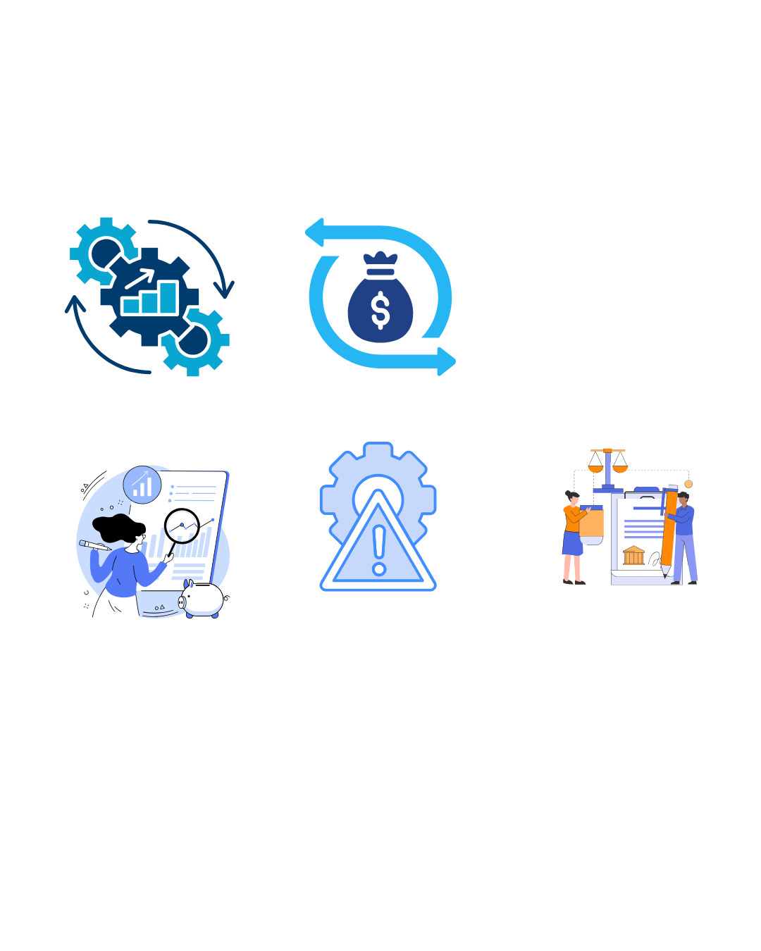
Types of Corporate Restructuring Strategies
Corporate restructuring isn’t one size fits all. It usually falls into two broad parts which is operational and financial. Each with its own playbook depending on the company's goals and market pressures.
Operational Restructuring
Financial Restructuring
Focuses on modifying a company's asset structure and business operations to improve efficiency and competitiveness.
Addresses a company's capital structure and funding mechanisms to improve financial stability and performance.
Mergers and Acquisitions (M&A)
Debt Restructuring
Divestitures and Spin offs
Equity Recapitalization
Joint Ventures and Strategic Alliances
Changes to financial architecture
Legal and structural restructuring involves changes to a company's legal structure, governance or organizational design for efficiency, compliance or tax optimization.

Slide 4




Triggers and Drivers of Corporate Restructuring
Restructuring doesn’t happen out of nowhere. It’s often triggered by internal challenges like inefficiencies or leadership shifts and external shocks like market changes or industry disruption. Spotting these signs early helps companies know when it’s time to hit reset.
Economic & Financial Pressures
Market Disruption & Tech Change
88% of 2023-2024 bankruptcies cited rising costs (inflation/interest rates). COVID-19 impacted 79%, increased competition 58%.
Rapid tech advancement forces restructuring for competitiveness. Digital transformation requires new models and skill sets.
Strategic Realignment
Regulatory & Compliance
Proactive restructuring to enter new markets, optimize portfolios, or respond to customer demands.
Changes in regulations, tax structures, or compliance can necessitate restructuring for legal operation and optimization.

Slide 5
Case Studies of Successful Corporate Restructuring
Examining real world examples provides valuable insights into effective restructuring strategies and their outcomes.
IBM's Strategic Transformation
Nokia's Comprehensive Approach
General Electric's Multi-Phase Transformation
Facing $16B losses (1991-93), IBM shifted from hardware to software and services, streamlined operations, and formed new partnerships. This resulted in sustained growth and competitive advantages.
In 2011, Nokia transitioned to Microsoft Windows for smartphones, closed R&D centers and factories (affecting 18,000 employees), and supported displaced staff with the "Bridge" program.
GE divested non core businesses, reduced GE Capital and ultimately split into three independent companies (GE Aerospace, GE Vernova, GE HealthCare) in 2024, creating more value.

Slide 6






The Corporate Restructuring Process
Successful restructuring requires a systematic approach addressing strategic, operational and stakeholder considerations.
Strategic Assessment
Stakeholder
Alignment
Legal
Consideration
Communication
Implementation
Effective communication is fundamental, requiring tailored messages for different stakeholder groups and coordinated delivery across multiple channels.

Slide 7
Risks and Challenges in Corporate Restructuring
Corporate restructuring involves significant risks that companies must navigate carefully for successful outcomes.
Financial & Operational Risks
Stakeholder & Market Risks
Legal & Regulatory Risks
High implementation costs
Employee resistance and morale issues
Compliance failures
Operational disruption
Disruption to customer/supplier relationships
Stakeholder legal challenges
Integration challenges (M&A)
Negative market perception
To make restructuring work without chaos, companies need a solid game plan. That means detailed prep, the right expert advice, rolling out changes step by step and keeping stakeholders in the loop throughout.

Slide 8
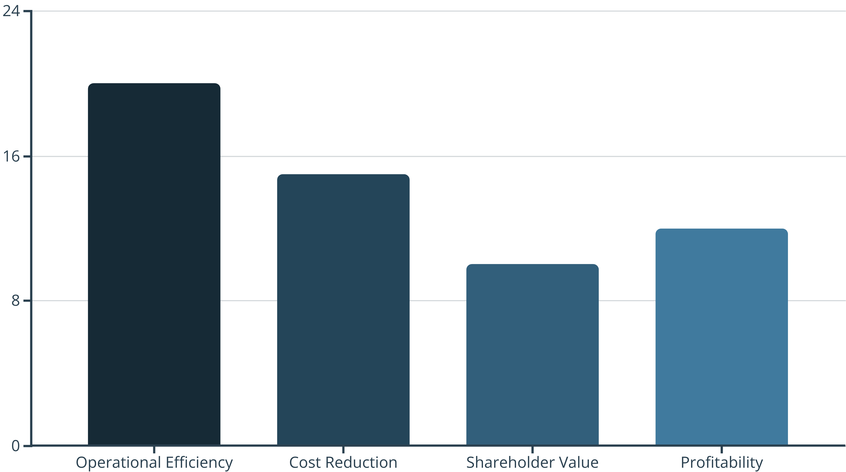
Financial Impact and Post-Restructuring Performance
Well executed restructuring can deliver substantial financial benefits and improved long term performance.
20% Improvement
15% Improvement
12% Improvement
10% Improvement
Most successful initiatives show positive financial impacts within 12-18 months. Operational restructuring
typically achieves 15-25% cost reductions in targeted areas within two years.

Slide 9




Future Trends in Corporate Restructuring
The corporate restructuring landscape is rapidly evolving, driven by technology, changing business
models, and new market dynamics.
Technology-Enabled
Agile & Adaptive
AI, automation, blockchain for data analytics, scenario modeling, and transparent transactions.
Combining traditional restructuring with agile methodologies for flexible, responsive structures.
Sustainability & ESG
Workforce & Culture
ESG considerations influencing decisions, integrating circular economy principles.
Emphasis on employee experience, skills development, and cultural transformation.

Slide 10
Strategic Recommendations & Imp Takeaways
When markets get messy, corporate restructuring can be a game changer. But it’s not just about shaking things up it needs deep planning, smart engagement with stakeholders, strong risk controls and regular performance check ins to truly work.
Strategic Planning: Develop clear vision, adopt comprehensive planning, implement phased execution.
Stakeholder Engagement: Prioritize engagement, transparent communication, two-way channels.
Operational Excellence: Focus on core value, robust risk management, continuous monitoring.
Future-Readiness: Embrace technology, build agility, invest in workforce development.
Long-term Value: Align with ESG, create sustainable advantages, plan for continuous evolution.
In fast moving markets, restructuring isn’t just for survival it’s a smart strategy for growth. The companies that treat it as a long term capability, not just a reaction to crisis, are the ones that truly thrive.

